Slide 1
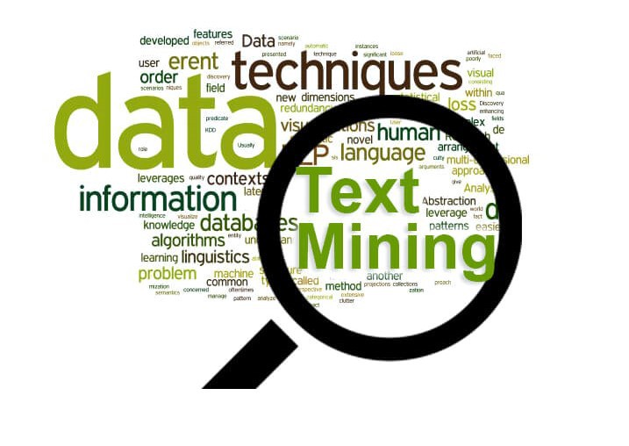

Sparkler for Documents search
CSC 6760: Big Data Programming
November 28, 2022

Slide 2
Agenda
Introduction
Project Team
Project Introduction
Objective
Project Flow
Algorithms
References

Slide 3

Project Team
Guide -
Dr. Mario Kubek
mkubek@gsu.edu
Asst. Professor,
Georgia State University
Project Group -
1. Pooja Baba
pbaba1@student.gsu.edu
2. Avinash Goli
agoli2@student.gsu.edu

Slide 4
Objective
Using crawler to fetch corpus of data from documents database and seed URLs even with the headless browsers using selenium.
The project’s objective is to crawl the web on behalf of the user to look for relevant documents on the web – research articles, journal articles, etc.
The documents and references presented will be based on their semantic similarity with the keywords.

Slide 5
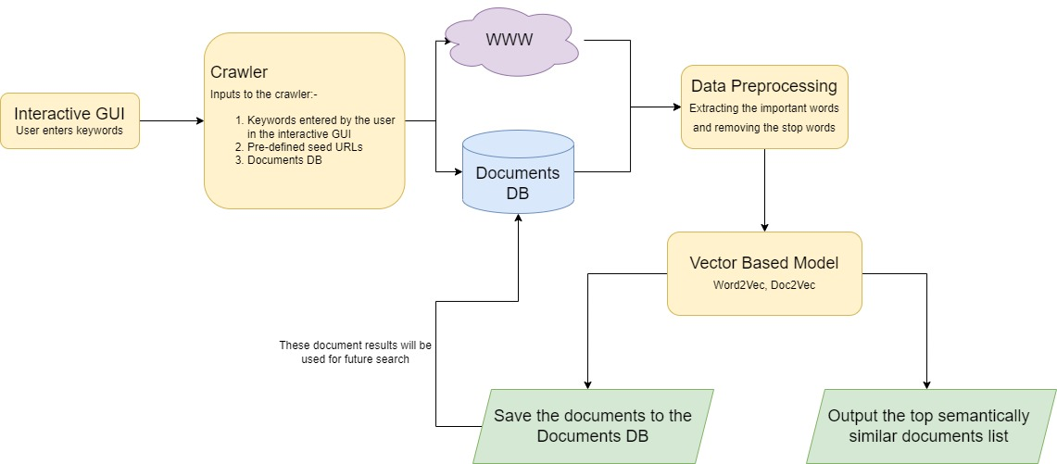
Project Flow

Slide 6
Algorithms/Libraries Used
BeautifulSoup
Web scrapper implementation
Downloading files
TF-IDF Cosine Similarity
Implemented using pandas
Word2Vec
Implemented using pyspark’s mllib genism library
Created vocabulary using word2Vec
Presented most similar words to the user based on the keywords input
Doc2Vec (incomplete)
Notes:
Word2Vec:
PySpark’s ML package
Trains a model of Map(String, Vector) (transforms a word into a code for further natural language processing or ML process)
TF-IDF to do the initial level of data preprocessing

Slide 7
References
Graph-based Text Mining using the Hagen NLPToolbox – Dr. Kubek

Slide 8

THANK YOU
Any Questions?

